Slide 1
Vocabulary Clip Library

Slide 2
Table of Contents
Explicit Vocabulary and Active Practice
Supporting mastery of new words
Explicit Vocabulary: Deepening Word Knowledge
Demonstrating knowledge of vocabulary
Implicit Vocabulary
Encountering words during reading

Slide 3
Explicit Vocabulary and Active Practice Vocabulary Clip Library

Slide 4
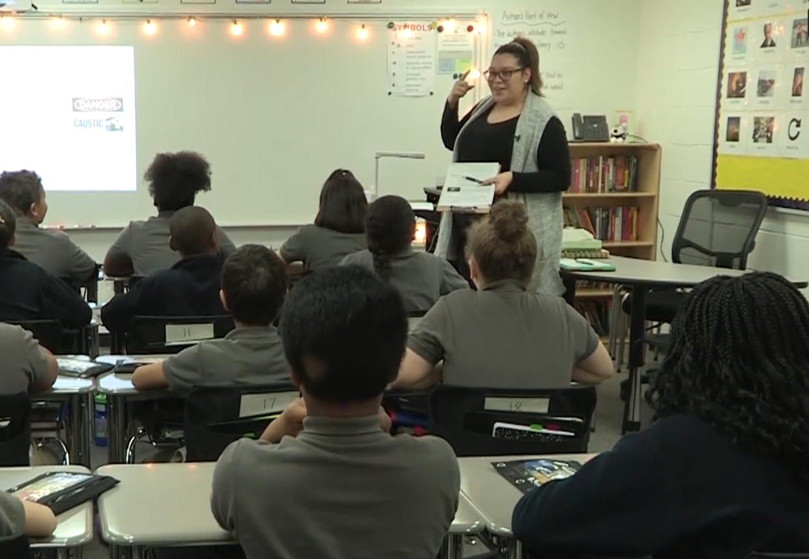
Christine Torres
What does Christine do to ensure that students will have a deep understanding of the word “caustic”?
Notes:
Clip Title: RC.Vocabulary.GR5.Torres.'Implore'.Clip2998.PNYCShorter
Context:
In this clip, Christine Torres leads Lesson 14 from the unit for Number the Stars, written by Lois Lowry, with a 5th grade class in Springfield, MA.
Christine is rolling out the Explicit Vocabulary word “implore” and leading her class in Active Practice.
Alternative Framing Questions:
How does Christine maximize student engagement?

Slide 5
Christine Torres
Front-loads the definition
Adds a visual
Multiple at-bats
Playful
Notes:
Notes on Explicit Vocabulary and Active Practice:
Front-loads the definition: Christine does not ask whether students know the definition of “caustic”—this can take up class time as students try to guess at a definition (or to provide an incorrect or halfway-there definition, which could stick in the minds of other students). Instead, Christine provides a student-friendly definition, part of speech, and related words, so that the students’ time is spent actually using the definition, strengthening the neural pathways necessary for recall and mastery of “caustic.” Christine also adds some information to the word “critical,” a part of the definition, to ensure that all her students have an accurate understanding.
Adds a visual: Christine shares a picture that conveys the definition visually as a way to make it “sticky” and durable in students’ minds. Note that Christine has these Explicit Vocabulary words and images posted on the bulletin board on the right side of the class—a further way to support students not only in recalling the definitions of their Explicit Vocabulary words, but also as a reminder to use them in their discussion and written responses.
Multiple at-bats: Christine varies her Means of Participation throughout the roll out and Active Practice, with an emphasis on Turn and Talk. This allows students multiple at-bats to pronounce, hear, and use the words, strengthening those neural pathways.
Playful: Christine adds her own take on the situation of a judges’ caustic remarks (“The judge would NEVER say that Miss Torres’ singing is horrible…”), modeling the word in a humorous situation and adding an element of playfulness to vocabulary instruction—in Miss Torres’ class, words are fun!
You might also consider this clip for:
Means of Participation
FAQs:
What does Christine do to prepare for this lesson?
Christine is ready with an explanation of “critical,” a word within the definition, to address possible confusion with the definition. She has intentionally scripted her means of participation to increase the at-bats students receive, giving more opportunities to say, to hear, and to use the words. Christine has planned to use the example sentence/situation and the visual to launch Turn and Talks, increasing students’ opportunities to dive deep into the contexts and use of “caustic.”
Are these strategies for Vocabulary instruction appropriate for students with diverse learning needs and multi-lingual learners?
Yes! The structure and elements of Christine’s vocabulary rollout are appropriate for all learners and effectively support students with diverse language and learning needs.

Slide 6
Explicit Vocabulary: Building Knowledge Vocabulary Clip Library

Slide 7
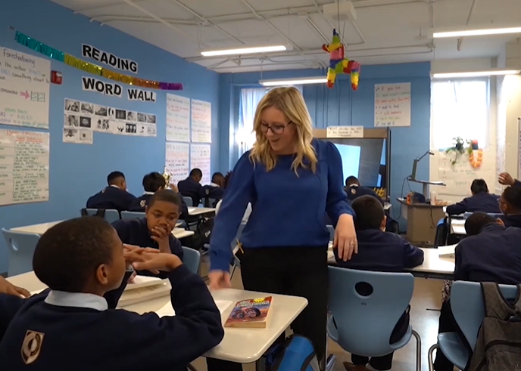
Sarah Wright
How does Sarah deepen and strengthen students’ word knowledge?
Notes:
Clip Title: EA.ShowCall.GR6.Wright.’Vivid.’Clip2913
Context:
In this clip, Sarah Wright leads lesson 11 from The Giver by Lois Lowry, with a 6th grade class in Chattanooga, TN.
Sarah has introduced the word “conspicuous,” and is leading Active Practice to deepen students’ understanding.
Alternative Framing Questions:
How does Sarah’s Active Observation support student learning?

Slide 8
Sarah Wright
Gives students independent think time
Incorporates writing
Reinforces and celebrates word knowledge
Notes:
Notes on Explicit Vocabulary and Building Knowledge
Gives students independent think time: The Stop and Jot question invites all students in, increasing engagement. Sarah can then observe student answers and first determine which students understand the definition, and then decide whether she needs to spend more time with the definition or can move on to other practice questions.
Incorporates writing: Sarah asks students to respond in writing to the active practice question, in a brief, 30-second Stop and Jot. The focus is not on crafting an exemplary sentence but on cementing the meaning of the word “conspicuous.”
Reinforces and celebrates word knowledge: During Sarah’s Active Observation, she notes that a student has demonstrated his understanding of “conspicuous” by using another Explicit Vocabulary word, “vivid,” which was taught in Lesson 6. Sarah recognizes that activating this prior knowledge will help strengthen students’ recall, and shares this example with the whole class. Throughout this clip, Sarah shows authentic excitement in her students and their work.
You might also consider this clip for:
Active Observation
FAQs for this clip:
What did Sarah do to prepare for this task?
Sarah made a slight adaptation to the question to make it more personal for students; she changes the location of the question to the local aquarium, a place her students are familiar with. This is another way to increase investment and engagement in the task.

Slide 9
Implicit Vocabulary Vocabulary Clip Library

Slide 10
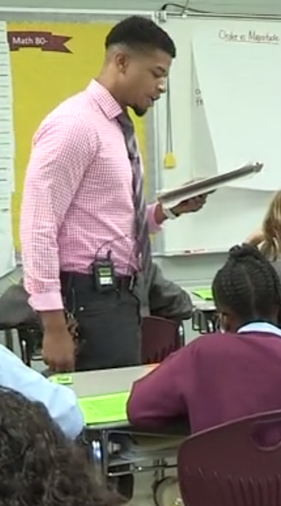
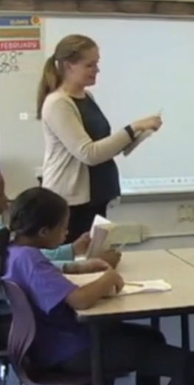
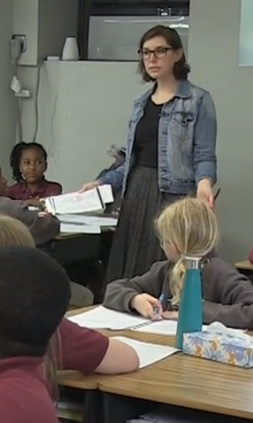
Implicit Vocabulary Montage
How do these teachers strategically reinforce Implicit Vocabulary to improve student comprehension?
Notes:
Clip Title: RC.Vocabulary.GRM.MultipleTeachers.’IV montage for RC’.Clip3058 Switch for RC.Vocabulary.GRM.MultipleTeachers.'Implicit vocab montage for RC.Clip3058.Hasan.Badillo.Harley.02.21.2020
Context:
In this clip, Rachel Harley, Emily Badillo, and Hasan Clayton illustrate various techniques for highlighting implicit vocabulary words that students come across in their reading.
Alternative Framing Questions:
How can we leverage reading to teach vocabulary?
How do teachers prepare to address implicit vocabulary with their students?

Slide 11
Implicit Vocabulary Montage
Clear, concise definition prepared
Brief and efficient to get right back into the text
(Sometimes) annotated in text
(Sometimes) quick active practice and/or connections to other words
Notes:
Notes on Implicit Vocabulary Montage:
Clear, concise definition prepared: Ahead of time, teachers determined which words might present barriers to student comprehension and pre-planned a student-friendly definition and means of participation. In Rachel’s case, she knew that a demonstration of a curtsey was more efficient than a definition.
Brief and efficient to get right back into the text: Each teacher balances adding knowledge that will increase student comprehension with the need to return quickly to the text to maintain interest and engagement with the reading.
(Sometimes) annotated in text: Each teacher determines whether annotation or a margin note will be necessary. Saving the definition may help students if they need to use it to answer questions later in the lesson, for example.
(Sometimes) quick active practice and/or connections to other words: Again, each teacher determine to what extent students should engage further with this word at this moment, striking a balance between practicing with the word and returning to the reading.
You might also consider this clip for:
Read Aloud
FAQs:
How do I prepare to teach Implicit Vocabulary?
As these clips demonstrate, preparation is key. Knowing your students will help you determine which words could present a barrier to comprehension. Knowing where your lesson is headed will help you to select words that are most important: Will this word help students access a central idea or a key point in the reading? Will this word support student analysis necessary to answer an upcoming question? Determining where these words occur in the reading allows you to make decisions about whether you or your students will read this section of text aloud. And practicing your Read Alouds will help you make efficient choices about pacing: how much time to spend on a particular word.

