Slide 1
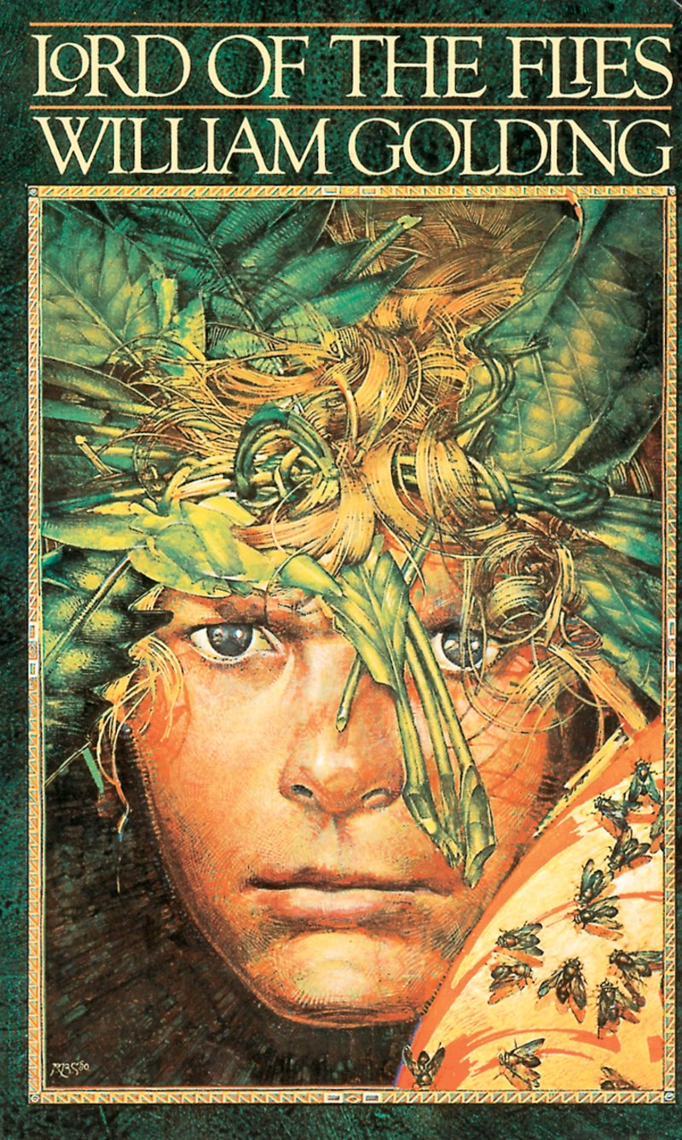
Retrieval Practice The Lord of the Flies
Notes:
Welcome! We are thrilled that are using our retrieval practice resource for The Lord of the Flier Curriculum Unit.
Retrieval Practice
Retrieval Practice is an academic system in which you ask students questions designed to help encode key knowledge into long-term memory. These questions draw on knowledge from the Knowledge Organizer, the novel itself, or recently read embedded texts.
Tips for Planning & Implementation
Plan your target response for each Retrieval Practice question. You might note these responses in your teacher-created version of the student packet or simply print out this RP deck.
Decide how students will respond to each Active Practice question: Turn and Talk, Cold Call, Raise Hands, Everybody Writes. Students do not need to write the response for every Retrieval Practice question.
The activity is designed to be fast and energetic with little discussion. The purpose is the retrieval. This helps encode the information in long term memory. A common mistake is to spend time discussing answers to these questions. If students are dying to discuss, it is of course permissible from time to time but doing so is likely to disrupt lesson timings. Occasionally, teachers may choose to engage in brief discussion based on data or to leverage student enthusiasm, but the focus of this section of the lesson should be quick, efficient, and accurate practice.
You will find two slides per retrieval practice. The first slide lists the questions. The second slide lists the answers. Each slide is labeled at the top with the lesson number. Within this deck you will find retrieval practice for lessons 3, 8, 11, and 15.
We currently have included timestamps for each set of questions but know that you may modify these timestamps depending on the needs of your students and length of your ELA block. Ideally, you want to ensure retrieval practice (both worktime and review) takes only 10 minutes.
Things to note:
Key terms from the knowledge organizer are written in blue.
Answers are written with key ideas or vocabulary in gold.
Answers which require examples from the teacher are noted in red. Additional examples are sometimes listed in the notes section of the slide.
Each retrieval practice is designed to be student self-scoring with each question worth 1 point unless otherwise noted on the slide. This will allow students to complete, score, and self-report their work.

Slide 2
Retrieval Practice: Lesson 3
What is the name of the paradise that God created in the Bible?
God created two people there. Who were they?
What were they forbidden from?
What is the Serpent?
What was the Fall?
What was the result of the Fall?
How does Lord of the Flies allude to the Serpent in the beginning of the novel?
What is hierarchy?
What is respect for authority?
What do you call it when individuals and government are regulated by law and not random action?
Take 3 minutes to complete these questions

Slide 3
Retrieval Practice Answers: Lesson 3
1. Garden of Eden is the name of the paradise that God created in the Bible.
God created Adam and Eve. Adam was created first. Eve was created using Adam’s rib.
3. They were forbidden to eat from the tree of knowledge of good and evil.
The Serpent was a religious symbol of deception and evil. It seduced Eve into eating a piece of forbidden fruit from the tree of knowledge.
The Fall references when Adam and Eve fell from innocence and obedience to God into betrayal and guilt.
The result of the Fall was eternal wounds upon humanity.

Slide 4
Retrieval Practice Answers: Lesson 3 (continued)
Lord of the Flies alludes to the Serpent in the beginning of the novel when it describes the creepers or vines that cover the island when the boys first arrive.
Hierarchy is when rank determines authority, status, and submission to those above.
Respect for authority is to show appreciation and obedience to those in a position of power.
When individuals and government are regulated by law and not random action it is called Rule of Law.
Self-score: ______ /10

Slide 5
Retrieval Practice: Lesson 8
1. What is the Scar?
2. What is the Scar a symbol for?
3. What is the symbolism of Ralph and Jack in relationship to one another?
4. How does a civilization encourage proper behavior?
5. What does “respect for traditions” mean within a society?
6. What does Piggy symbolize?
What does Simon symbolize?
8. Think of a description of Simon in Lord of the Flies that alludes to the Bible.
9. In the Bible, what was The Fall of Man?
10. According to the Bible, what did humanity inherit from Adam and Eve?
Take 3 minutes to complete these questions

Slide 6
Retrieval Practice Answers: Lesson 8
1. The Scar is the wreckage of the airplane.
The Scar is a symbol of the first appearance of humans in nature or “paradise”.
3. Ralph and Jack’s relationship symbolizes <insert answer>.
A civilization encourages proper behavior through the Rule of Law.
“Respect for traditions” means to show commitment to the established customs of a society and transmit beliefs from generation to generation.
Piggy symbolizes intelligence and logic.
Simon symbolizes saintliness and wisdom.
Notes:
.

Slide 7
Retrieval Practice Answers: Lesson 8 (continued)
A description of Simon that alludes to the Bible is when the littleuns run after Simon because he will help them get fruit that they cannot reach. They fully trust him and rely on his kindness for their survival.
The Fall of Man was when Adam and Eve fell from innocence and obedience to God into betrayal and guilt.
According to the Bible, humanity inherited eternal wounds from Adam and Eve.
Self-score: ______ /10
Notes:
.

Slide 8
Retrieval Practice: Lesson 11
What is an allusion?
How are the vines or “creepers” in Lord of the Flies an allusion?
What does the signal fire symbolize?
What does the conch shell symbolize?
What is human nature?
Which philosopher is known for saying life is “nasty, brutish, and short?”
Fill in the blank. John Locke believed humans were a “blank ____________.”
What does Jean-Jacques Rousseau mean by “state of nature?”
What did Rousseau believe about humankind in a “state of nature?”
What is an allegory?
Take 3 minutes to complete these questions

Slide 9
Retrieval Practice Answers: Lesson 11
An allusion is a reference to a significant historical, literary, cultural, or political figure or idea?
2. The vines or “creepers” are an allusion is because they refer to snake or serpent which is a religious symbol of evil or deception.
The signal fire symbolizes a connection to modern society and civilization.
The conch shell symbolizes the power of civilization and ordered society.
5. Human nature is qualities and characteristics that humankind possesses at birth.
Thomas Hobbes said life is “nasty, brutish, and short.”
7. John Locke believed humans were a “blank slate.”

Slide 10
Retrieval Practice Answers: Lesson 11 (continued)
8. Jean-Jacques Rousseau said humans were inherently good & peaceful in a “state of nature.”
In a “state of nature” humankind is “isolated, timid, peaceful, and mute.”
10. An allegory is a narrative that uses characters or events to represent ideas or events.
Self-score: ______ /10

Slide 11
Retrieval Practice: Lesson 15
Name three of the five characteristics of civilization from your Knowledge Organizer.
Why are Piggy’s specs so important? What do they symbolize?
What’s an example of an event in the book that is ominous? Why is it ominous?
Who is the most depraved character in the book? Give an example of his depravity.
Who is the most civilized character in the book? Give an example of why you think so.
Give an example of someone behaving hysterically in the novel.
Whose theory on the state of nature is better demonstrated by the boys’ actions in the past chapters, Rousseau’s or Hobbes’s?
Why?
Take 3 minutes to complete these questions

Slide 12
Retrieval Practice Answers: Lesson 15
1. Characteristics of Civilization
Hierarchy: Rank determines authority, status, and submission to those above
Respect for Authority: To show appreciation and obedience to those in a position of power
Rule of Law: individuals and government obey law, crime is met with punishment in order to enforce proper behavior
2. Piggy’s specs are important because they symbolize the power of science and reason and the ability to see things clearly
3. One event that is ominous is when Jack said, “We mustn’t let anything happen to Piggy, must we?” The lines are spoken either ironically or with a quiet viciousness that is ominous.
Notes:
Q.1: Possible answers:
Hierarchy
Rank determines authority, status, and submission to those above
Respect for Authority
To show appreciation and obedience to those in a position of power
Rule of Law
individuals and government obey law crime is met with punishment, in order to enforce proper behavior
Shared Values
Individuals in a society share fundamental beliefs and principles, helping them to keep faith in their society
Respect for Traditions
Show commitment to the established customs of a society and transmit beliefs from generation to generation
Q3: An additional event that was ominous was when the boys were pretending to hunt and Jack said, “Use a littlun.” The last line is ominous because after Robert proposes they use a real pig that they can actually kill, Jack suggests they use a littlun instead. This shows the degree of Jack’s violent instincts, implying that he would take pleasure in killing a human.

Slide 13
Retrieval Practice Answers: Lesson 15 (continued)
Jack is the most depraved character in the book because he behaves with savagery when he suggests to kill one of the smaller children.
____________ is the most civilized character in the book because he <insert answer here>.
The boys are hysterical when they believe that “the beast” has intentionally placed itself by the signal fire, which they think provides them their sole chance of rescue. It is fair to say that they are hysterical because their fear of the beast has reached new levels.
Rousseau’s theory on the state of nature is better demonstrated by the boys’ actions in the past chapters because the boys are acting selfish and “in a constant state of war.” Ralph and Jack are enemies as Jack tries to displace Ralph as leader of the group.
Self-score: ______ /7
Notes:
Q.1: Possible answers:
Hierarchy
Rank determines authority, status, and submission to those above
Respect for Authority
To show appreciation and obedience to those in a position of power
Rule of Law
individuals and government obey law crime is met with punishment, in order to enforce proper behavior
Shared Values
Individuals in a society share fundamental beliefs and principles, helping them to keep faith in their society
Respect for Traditions
Show commitment to the established customs of a society and transmit beliefs from generation to generation
Q3: An additional event that was ominous was when the boys were pretending to hunt and Jack said, “Use a littlun.” The last line is ominous because after Robert proposes they use a real pig that they can actually kill, Jack suggests they use a littlun instead. This shows the degree of Jack’s violent instincts, implying that he would take pleasure in killing a human.
Q5: Teacher should provide example as multiple examples exist. Be sure students root answer with evidence from the text.

