Slide 1
Show Call Clip Library

Slide 2
Table of Contents
Positive Show Call Culture
Positively framing student work for study in order to make students comfortable and excited to have their work shared
Show Call to Support Revision
Use Show Call to launch a whole class revision task
Take and Reveal
What you say and do as you take a paper from a student’s desk and show it to the class

Slide 3
Positive Show Call Culture Show Call Clip Library

Slide 4
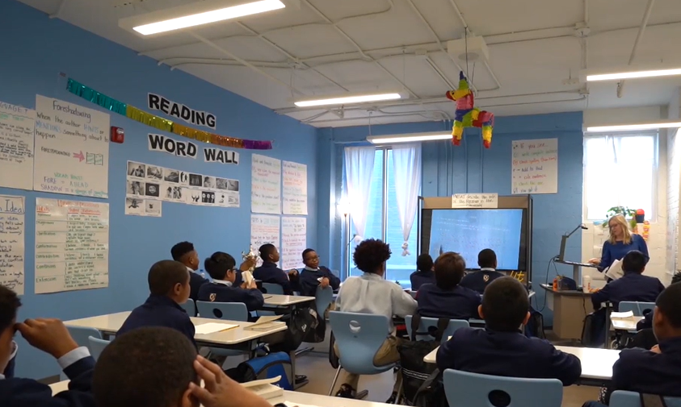
Sarah Wright
How does Sarah use Show Call to support understanding of a key moment in the text?
Notes:
Clip Title: RC.ShowCall.Gr6.Wright.’Describe the role of the Receiver.’Clip3414
Context:
In this clip, Sarah Wright leads a lesson from the unit for The Giver, by Lois Lowry, with a sixth-grade class in Chattanooga, TN.
Sarah is teaching Lesson 11, and students are analyzing how Jonas feels as he prepares to meet The Receiver.
Alternative Framing Questions:
How does Sarah build a Culture of Error?

Slide 5
Sarah Wright
Show Call is an entry point to discussion
Emphasizes positivity and teamwork
Culture of Error
Opportunity for revision
Notes:
Notes on Show Call:
Show Call is an entry point to discussion: Sarah reads a student’s unfinished response and asks the class to help finish the thinking. Having a shared visual reference to student work supports a deeper discussion grounded in specific details.
Emphasizes positivity and teamwork: Takes “Corian has us started…” - not “Corian didn’t finish.” “We are going to help Corian finish his answer.” Sarah uses “we” instead of “you” or “I.”
Culture of Error: She also shows emotional constancy - she treats this as completely normal. Corian’s work is an opportunity for the class to learn together.
Opportunity for revision: Sarah reveals that “some students are getting this down” - highlighting that many students were struggling with this question and giving them another chance to work through it. She also offers a push for those who were already there (“Some students are ready to add on to this”) to push the group to expand and elaborate on each other’s thinking.
You might also consider this clip for:
Culture of Error
Writing and Discussion
FAQs:
How does Sarah build a culture where students feel comfortable participating?
If Show Call is new in a classroom, you might consider starting by showing only exemplary work to establish a culture of sharing and celebrating student work, then gradually work towards Show Calling an “almost-there” answer for revision. It is important that both the “Take” (the moment when we take a student’s work to Show Call and the “Reveal” (the moment when we show student work to the class) are warm and positively framed.

Slide 6
Show Call to Support Revision Show Call Clip Library

Slide 7
Trista Rivera
How does Trista use Show Call to strengthen student writing?
Notes:
Clip Title: EA.ShowCall.GR8.Rivera.'Jadis ignored the children.'Clip2961
Context:
In this clip, Trista Rivera leads a lesson from the unit for The Magician’s Nephew, by C.S. Lewis, with an eighth-grade class in Chattanooga, TN.
Students are completing a developmental writing prompt where they add to a partial sentence to show their understanding of the text and to practice using more complex or unfamiliar sentence structures. Here students are asked to start with the phrase, “Despite being in the presence of Queen Jadis, . . . “
Alternative Framing Questions:
What systems has Trista established in her classroom to support effective Show Call?

Slide 8
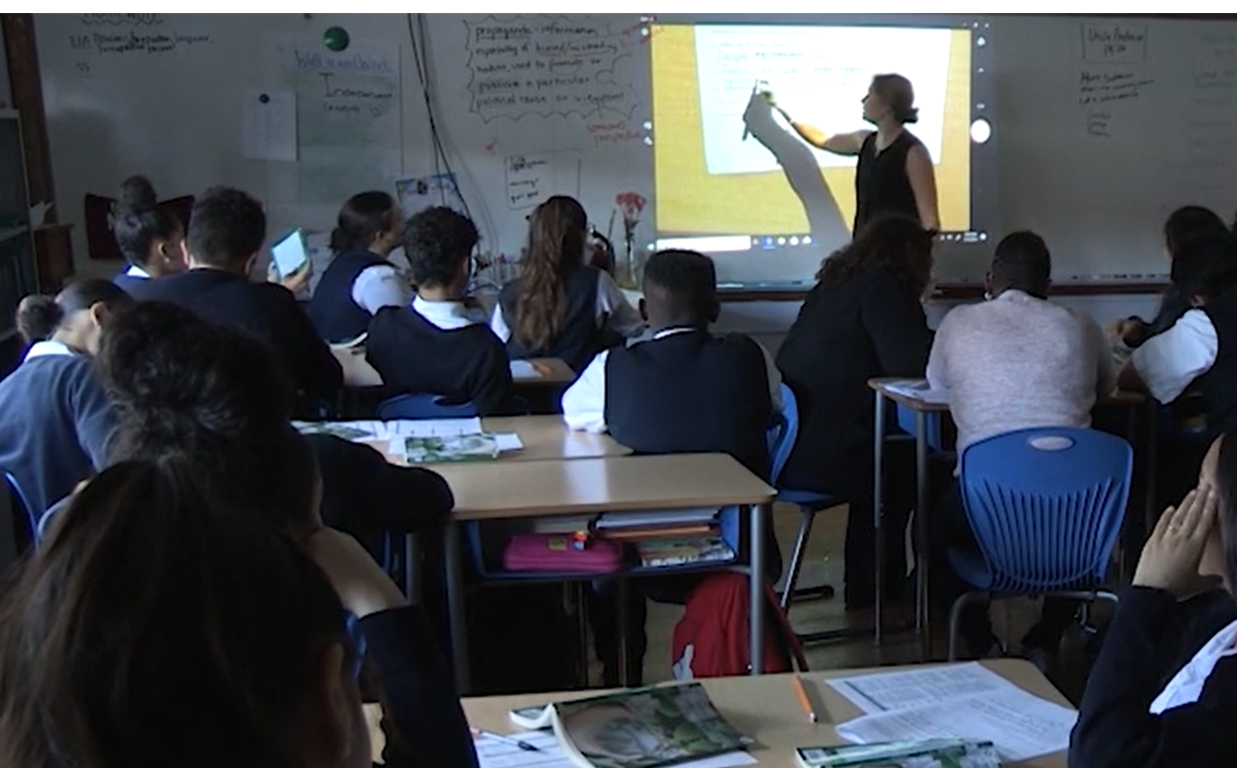
Trista Rivera
Show Calls exemplary work
Increases Think Ratio
Opportunity to revise thinking
Notes:
Notes on Show Call:
Show Calls exemplary work: Trista Show Calls Andrina’s response as a model from which other students can learn. She honors Andrina’s work by sharing with the class, so they can learn from it and she asks Andrina to read it aloud.
Increases student think ratio: Trista asks the students to identify the strengths in Andrina’s writing, placing the critical analysis on students.
Opportunity to revise thinking: Trista stamps the key take-away from the discussion stating “She uses this because to lead her into the explanation of why.” highlighting what makes the sentence exemplary. Trista then tasks all students to “tack on the word ‘because’ to explain why . . .” giving every student a chance to elaborate their thinking.
You might also consider this clip for:
Revision
Developmental writing
FAQs:
How does Trista build a culture where students feel comfortable sharing their work?
If Show Call is new in a classroom, you might consider starting by showing only exemplary work to establish a culture of sharing and celebrating student work, then gradually work towards Show Calling an “almost-there” answer for revision. It is important that both the “Take” (the moment when we take a student’s work to Show Call and the “Reveal” (the moment when we show student work to the class) are warm and positively framed.

Slide 9
Take and Reveal Show Call Clip Library

Slide 10
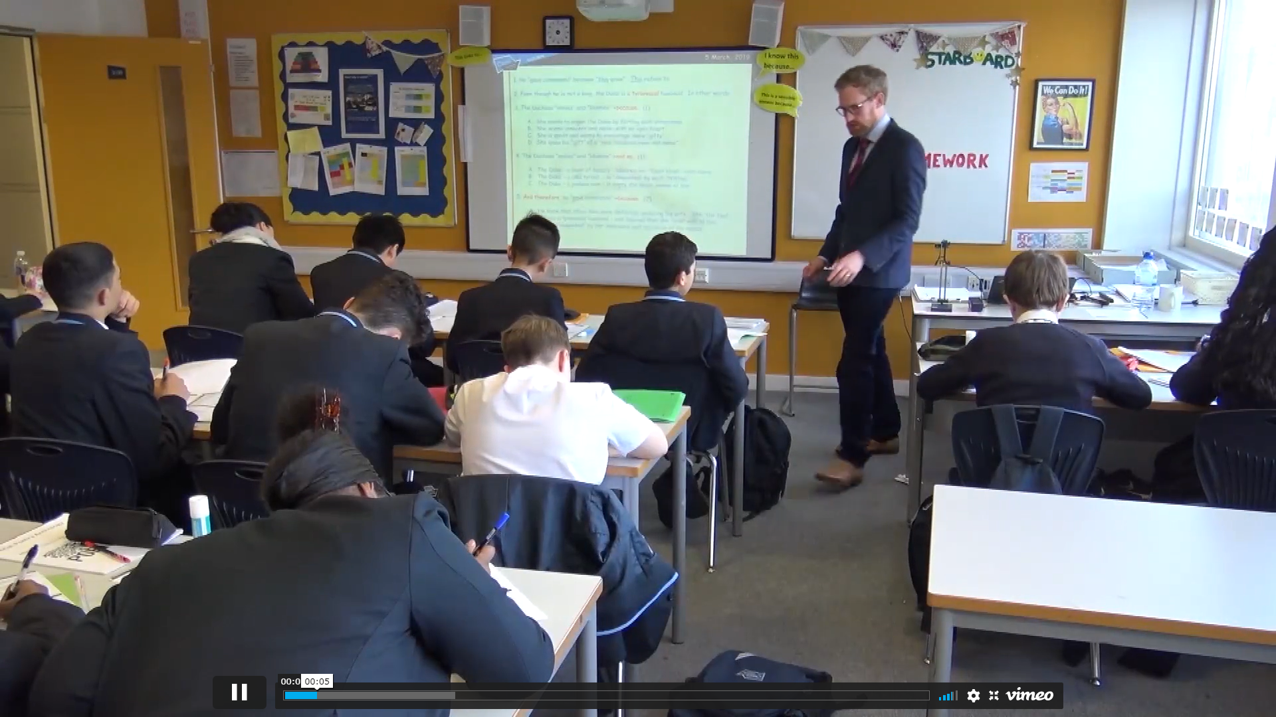
Take and Reveal Montage
What actions do teachers take to make the Take and Reveal feel positive?
Notes:
Clip Title: EA.ShowCall.GRM.'Take and Reveal montage.'Clip2461
Context:
In this clip, we see multiple teachers “Take” (the moment when we take a student’s work to Show Call and the “Reveal” (the moment when we show student work to the class.
Alternative Framing Questions:
What are some key take-aways when planning your take?
What are some take-aways when planning your reveal?

Slide 11
Take and Reveal Montage
The Take
Conveys a sense of normalcy, routine
Conveys appreciation for student work both in body language and words
Shares a purpose
The Reveal
Positively framed
Student work is honored
Shares the purpose and diffuses the pressure
Notes:
Notes on Take and Reveal:
The Take:
The first clip the teacher simply says “Do you mind?” conveying a calm sense of normalcy.
In the second clip we see the teacher, Natasha, take 3 separate papers as she circulates. She does not speak but looks admiringly at the papers and the students barely move emphasizing the normalcy of the act. This is a regular everyday routine.
In the third clip we see Maggie ask a student if she may share the work. Maggie crouches down to the student’s eye level to whisper as she shares her purpose, “Do you mind if I share your work so we can revise it a little?’
Reveal:
Maggie’s reveal feels positive. She shares her rationale, “I saw many of us doing this,” and then introduces the revision task. As she shares the student’s response she celebrates the student, his willingness to share with the words “graciously agreed . . “ followed by a prop.
In the second reveal example, the teacher conveys positivity when revealing work to be revised. “It’s pretty good right now, how can we make it even better?”
In the final clip Rousseau celebrates student work with a quick request, “snap it up for . . .” He then shares 2 pieces of student work and introduces the task to figure out which one is stronger. The celebration at the start messages to students the value seen in their work.
You might also consider this clip for:
Culture of Error

