Slide 1
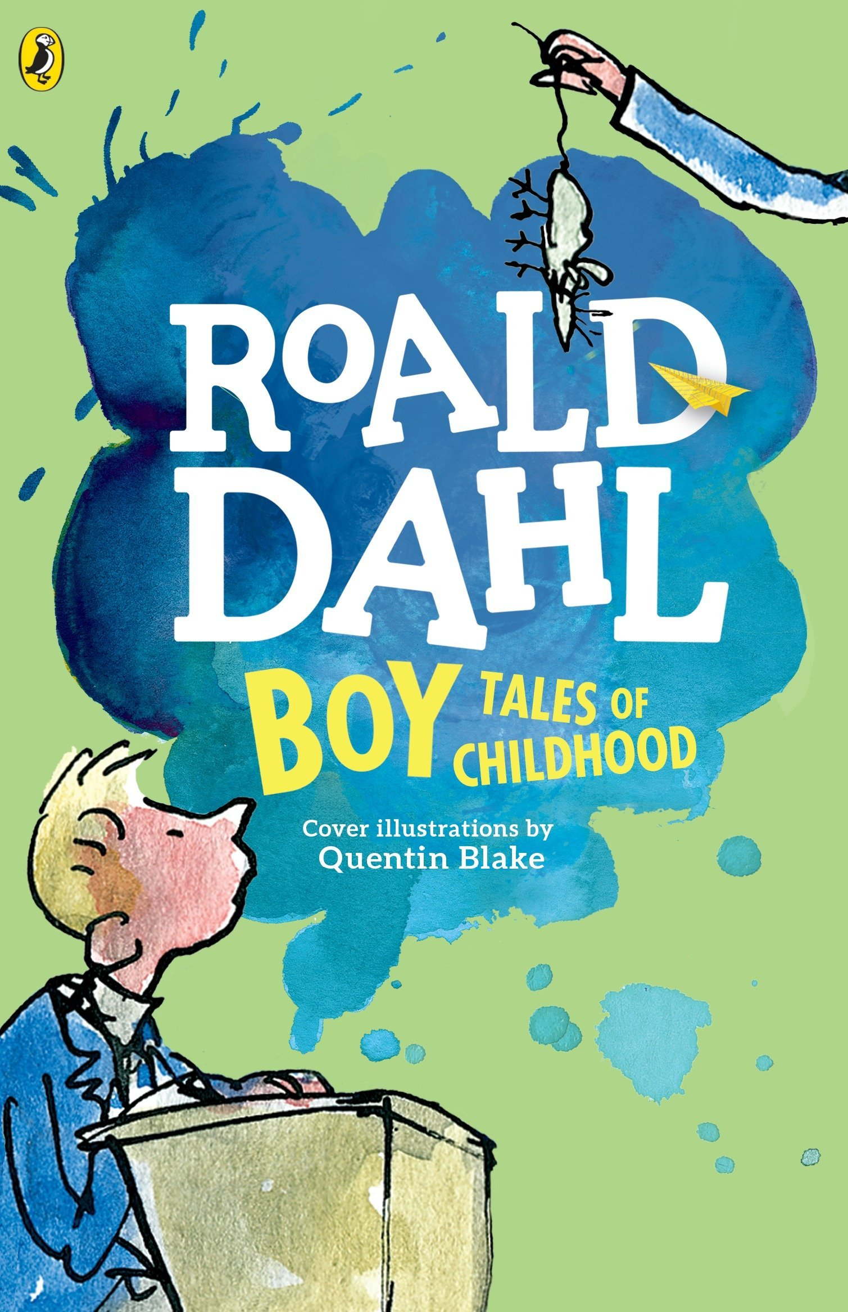
Retrieval Practice Boy Tales of Childhood
Notes:
Welcome! We are thrilled that are using our retrieval practice resource for Curriculum Unit on Boy.
Retrieval Practice
Retrieval Practice is an academic system in which you ask students questions designed to help encode key knowledge into long-term memory. These questions draw on knowledge from the Knowledge Organizer, the novel itself, or recently read embedded texts.
Tips for Planning & Implementation
Plan your target response for each Retrieval Practice question. You might note these responses in your teacher-created version of the student packet or simply print out this RP deck.
Decide how students will respond to each Active Practice question: Turn and Talk, Cold Call, Raise Hands, Everybody Writes. Students do not need to write the response for every Retrieval Practice question.
The activity is designed to be fast and energetic with little discussion. The purpose is the retrieval. This helps encode the information in long term memory. A common mistake is to spend time discussing answers to these questions. If students are dying to discuss, it is of course permissible from time to time but doing so is likely to disrupt lesson timings. Occasionally, teachers may choose to engage in brief discussion based on data or to leverage student enthusiasm, but the focus of this section of the lesson should be quick, efficient, and accurate practice.
You will find two slides per retrieval practice. The first slide lists the questions. The second slide lists the answers. Each slide is labeled at the top with the lesson number. Within this deck you will find retrieval practice for lessons 3, 9, 12, and 16.
We currently have included timestamps for each set of questions but know that you may modify these timestamps depending on the needs of your students and length of your ELA block. Ideally, you want to ensure retrieval practice (both worktime and review) takes only 10 minutes.
Things to note:
Key terms from the knowledge organizer are written in blue.
Answers are written with key ideas or vocabulary in gold.
Answers which require examples from the teacher are noted in red. Additional examples are sometimes listed in the notes section of the slide.
Each retrieval practice is designed to be student self-scoring with each question worth 1 point unless otherwise noted on the slide. This will allow students to complete, score, and self-report their work.

Slide 2
Retrieval Practice: Lesson 3
1. What is an autobiography?
2. Does Roald Dahl consider Boy to be an autobiography? Why or why not?
3. What is an anecdote?
4. Describe one anecdote we have read about Roald Dahl’s father, Harald?
5. What is a humorist?
6. What does macabre mean?
7. Describe a macabre moment in Boy so far.
Take 3 minutes to complete these questions

Slide 3
Retrieval Practice Answers: Lesson 3
1. An autobiography an account or telling of a person's life written by that person.
2. Dahl seems to think that most autobiographies are full of boring details; they are a “history” of a person. Roald Dahl does not consider Boy an autobiography he would never write a boring book; he is telling a series of interesting and important stories about himself as opposed to writing his own history.
3. An anecdote is a short, amusing story about a real person or event.
4. There are several anecdotes about Harald: Harald and Roald Dahl’s mom would go on expeditions up into the mountains of Norway and he would scare her by climbing one-handed up steep cliffs to get small plants growing on a rocky ledge; He lost his arm as a little boy after a doctor made a drunken mistake; He believed that if a pregnant woman walked in beautiful places then the child would grow to love beauty.
5. Humorists are artists and thinkers who use comedy in their writing and speaking.
6. Macabre means grim and horrifying because it is related to death or injury.
7. A macabre moment in Boy so far was when Harald was injured and the doctor mistook Harald’s fractured elbow for his shoulder, causing him to lose his arm.
Notes:
NOTE: Q4: Lots of answers could be acceptable here; any text-based anecdote is valid.

Slide 4
Retrieval Practice: Lesson 9
What is hyperbole?
2. What is a caricature?
Name a person whom Dahl caricatures in Boy.
Describe a cautionary tale that Thwaites tells his friends.
What is a parody?
Why might we consider Thwaites’ cautionary tale to by a parody?
What does it mean to be grotesque?
Name a character we have met so far whom you might describe as grotesque. Why would you describe them this way?
What is artistic license?
Why might an author take artistic license when telling a story?
Take 3 minutes to complete these questions

Slide 5
Retrieval Practice Answers: Lesson 9
Hyperbole is obvious, intentional exaggeration designed to make a point.
A caricature is a description or image of someone with certain aspects exaggerated for comic effect.
Mr. Coombs and Mrs. Pratchett are caricatured in Boy. Roald Dahl does this to exaggerate the meanness and ugliness of his characters to emphasize how evil his villains are but also to let us laugh at them.
Thwaites tells his friends several cautionary tales: that liquorice is made of rats’ blood, and that adults put chloroform in Tonsil Ticklers to keep children quiet.
A parody is an imitation of a particular idea or style that is exaggerated for comic effect.
The stories Thwaites tells are parodies because they’re so clearly exaggerated and ridiculous.
Grotesque means comically, repulsively ugly or distorted
Self-score: ______ /10
Notes:
.

Slide 6
Retrieval Practice Answers: Lesson 9
8. Grotesque characters include Mr Coombs and Mrs Pratchett. Both characters are described as comically disgusting. Pratchett is literally filthy and Coombes is greasy and has a “face like a ham.”
9. Artistic license is the understanding that an author might distort or alter facts slightly in the creation of a piece of literature while maintaining the spirit of the truth.
10. An author might take artistic license in order to infuse their voice or their perspective in the telling of the story.
Self-score: ______ /10
Notes:
.

Slide 7
Retrieval Practice: Lesson 12
What is one characteristic of British humor?
What is nostalgia?
Describe an aspect of Dahl’s trips to Norway that he found to be idyllic.
What is penicillin?
Why was penicillin an important medical discovery?
What does it mean to have a “stiff upper lip”?
Take 3 minutes to complete these questions

Slide 8
Retrieval Practice: Lesson 12
British humor includes innuendo, sarcasm, and dry or deadpan humor.
Nostalgia is a fond remembering of the past, especially a longing for a time or place with happy personal memories
Dahl found Norway to be idyllic in several ways: visiting his grandparents and eating together in Oslo; sailing down the fjords to the island; the huge breakfast they ate every morning, swimming and playing on their secret island; etc.
Penicillin is one of the world’s first antibiotics, which are medicines that destroy or slow down the growth of disease-causing bacteria.
Penicillin was an important medical discovery because used to treat a wide variety of infections including pneumonia and scarlet fever. It can also heal infections in wounds and has been used to help prevent bacterial complications during and after surgical procedures. Illnesses and injuries that were once dangerous and fatal, such as appendicitis or strep throat, are today considered mild and easy to treat.
Having a “stiff upper lip” means experiencing hardship without showing emotion.
Self-score: ______ /6

Slide 9
Retrieval Practice Answers: Lesson 16
What is one characteristic of British humor?
What event does Dahl describe as an awful pantomime?
What does epistolary mean?
Describe subversive humor.
What is satire?
Name a reason that English schoolchildren wore uniforms.
Take 3 minutes to complete these questions
Self-score: ______ /7

Slide 10
Retrieval Practice Answers: Lesson 16
British humor includes innuendo, sarcasm, and dry or deadpan humor.
The scene in Mr. Coombe’s office is described as “awful pantomime.” Dahl used the scene to emphasize how performative the adults are during this scene. Instead of a performance designed to entertain children, like a real pantomime, this scene is designed to torture children for the entertainment of the adults.
Epistolary is writing that takes the form of a letter from one person to another.
Subversive humor is intended to expose, criticize, or undermine systems and institutions of power.
Satire is humor that is meant to expose foolishness and flaws.
School uniforms emphasize conformity, and proponents believe that they help students fit into a common school culture.
Self-score: ______ /6

